Slide 1

Course Title: DIGITAL DESIGN AND COMPUTER ORGANISATION
Course Code: BCS302
Course Type: IPCC
Semester: III
Year: 2025-26
Contact Hours/ week : L-T-P : 3:0:2
Dept of CSE

Slide 2
Logic gates
The basic logic gates are the building blocks of more complex logic circuits.
These logic gates perform the basic Boolean functions, such as AND, OR, NAND, NOR, Inversion, Exclusive-OR, Exclusive-NOR.
The small circle on the output of the circuit symbols designates the logic complement.
The AND, OR, NAND, and NOR gates can be extended to have more than two inputs.
Logic gates are electronic circuits that operate on one or more input signals to produce an output signal.
Dept of CSE

Slide 3
Logic gates
The gates are blocks of hardware that produces the equivalent of logic 1 or logic 0 output signals if input logic requirements are satisfied.
Gate INPUTS are driven by voltages having two nominal values, e.g. 0V and 5V representing logic 0 and logic 1 respectively.
The OUTPUT of a gate provides two nominal values of voltage only, e.g. 0V and 5V representing logic 0 and logic 1 respectively.
There is always a time delay between an input being applied and the output responding.
Dept of CSE

Slide 4
The different types of logic gates
NOT GATE: It has one input and one output. The output is the complement of the input.
2. OR GATE: The gate has two inputs and one output. The output is logic “1” when either of the inputs or both the inputs are at logic “1”.
3. AND GATE: The gate has two inputs and one output. The output is logic “1” only when both the inputs are high.
4. NAND GATE: It is an AND gate followed by a NOT gate. It is the complement of AND gate. The output is logic “0” when both the inputs are at logic “1”, else the output is always in the high state.
5. NOR GATE: It is an OR gate followed by a NOT gate. It is the complement of OR gate. The output is logic “1” when both the inputs are at logic “0”, else the output is always in the low state.
6. EXOR GATE: It is logic gate whose output is in the high state when both the inputs are not same. When the both the inputs are high and when both are low, the output is low.
7. EXNOR GATE: It is logic gate whose output is in the high state when the both the inputs are high and when both are low .The output is low when both the inputs are not same.
Dept of CSE

Slide 5
AND GATE
PIN DIAGRAM
SYMBOL
Dept of CSE

Slide 6
OR GATE:
Dept of CSE

Slide 7
NOT GATE
SYMBOL PIN DIAGRAM
Dept of CSE

Slide 8
X-OR GATE :
SYMBOL PIN DIAGRAM
Dept of CSE

Slide 9
2-INPUT NAND GATE:
SYMBOL PIN DIAGRAM
Dept of CSE

Slide 10
3-INPUT NAND GATE
Dept of CSE

Slide 11
BASIC THEOREMS AND PROPERTIES OF BOOLEAN ALGEBRA:
Duality
The important property of Boolean algebra is called the duality principle and states that every algebraic expression deducible from the postulates of Boolean algebra remains valid if the operators and identity elements are interchanged.
In a two‐valued Boolean algebra, the identity elements and the elements of the set B are the same: 1 and 0. The duality principle has many applications.
If the dual of an algebraic expression is desired, we simply interchange OR and AND operators and replace 1’s by 0’s and 0’s by 1’s.
Basic Theorems
Table 1 lists out six theorems of Boolean algebra and four of its postulates. The theorems and postulates listed are the most basic relationships in Boolean algebra.
The theorems, like the postulates, are listed in pairs; each relation is the dual of the one paired with it. The postulates are basic axioms of the algebraic structure and need no proof.
The theorems must be proven from the postulates.
Dept of CSE

Slide 12
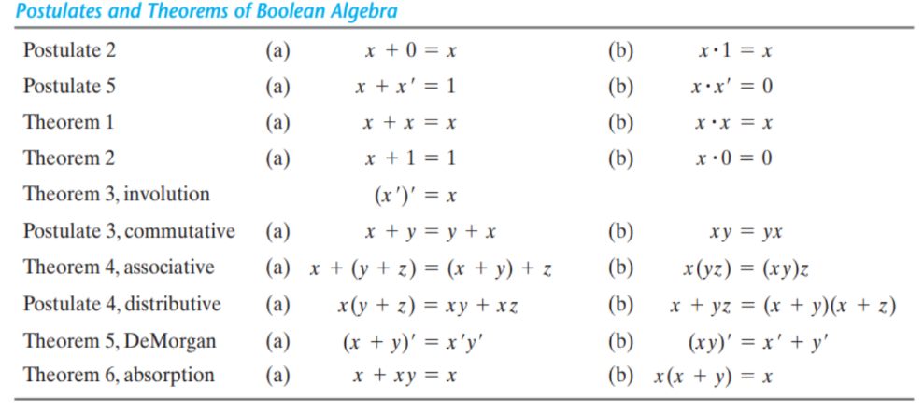
Dept of CSE

Slide 13
THEOREM 1(a): x + x = x.
Statement Justification
x + x = (x + x) . 1 postulate 2(b)
= (x + x)(x + x’) 5(a)
= x + xx’ 4(b)
= x + 0 5(b)
= x 2(a)
THEOREM 1(b): x . x = x.
Statement Justification
x . x = xx + 0 postulate 2(a)
= xx + xx’ 5(b)
= x(x + x’) 4(a)
= x . 1 5(a)
= x 2(b)
Note that theorem 1(b) is the dual of theorem 1(a) and that each step of the proof in part (b) is the dual of its counterpart in part (a)..
Dept of CSE

Slide 14
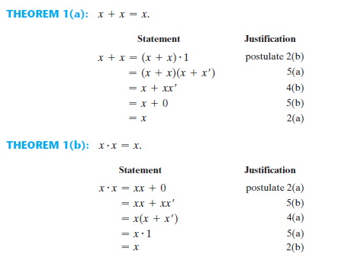
Dept of CSE

Slide 15
THEOREM 2(a): x + 1 = 1.
Statement Justification
x + 1 = 1 . (x + 1) postulate 2(b)
= (x + x')(x + 1) 5(a)
= x + x' . 1 4(b)
= x + x’ 2(b)
= 1 5(a)
THEOREM 2(b): x . 0 = 0 by duality.
Dept of CSE
THEOREM 3: (x')' = x. From postulate 5, we have x + x' = 1 and x . x' = 0, which together define the complement of x. The complement of x' is x and is also (x')’.
Therefore, since the complement is unique, we have (x')' = x. The theorems involving two or three variables may be proven algebraically from the postulates and the theorems that have already been proven.

Slide 16
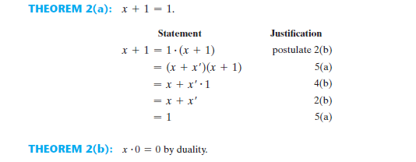
Dept of CSE
THEOREM 3: (x')' = x. From postulate 5, we have x + x' = 1 and x . x' = 0, which together define the complement of x. The complement of x' is x and is also (x')’.
Therefore, since the complement is unique, we have (x')' = x. The theorems involving two or three variables may be proven algebraically from the postulates and the theorems that have already been proven.

Slide 17
THEOREM 6(a): x + xy = x.
Statement Justification
x + xy = x . 1 + xy postulate 2(b)
= x(1 + y) 4(a)
= x(y + 1) 3(a)
= x . 1 2(a)
= x 2(b)
THEOREM 6(b): x(x + y) = x by duality.
Dept of CSE
The theorems of Boolean algebra can be proven by means of truth tables.
In truth tables, both sides of the relation are checked to see whether they yield
identical results for all possible combinations of the variables involved.

Slide 18
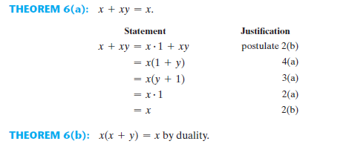
Dept of CSE
The theorems of Boolean algebra can be proven by means of truth tables.
In truth tables, both sides of the relation are checked to see whether they yield
identical results for all possible combinations of the variables involved.

Slide 19
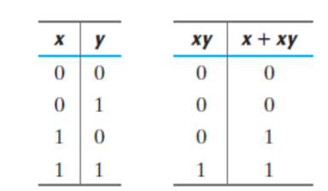
The following truth table verifies the first absorption theorem:
Dept of CSE

Slide 20
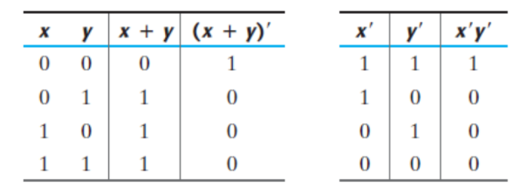
The truth table for the first DeMorgan’s theorem, (x + y)' = x'y', is as follows:
Dept of CSE
The truth table for the second DeMorgan’s theorem, (x y)' = x’+y', is as follows:

Slide 21
BOOLEAN FUNCTIONS
Boolean algebra is an algebra that deals with binary variables and logic operations.
A Boolean function described by an algebraic expression consists of binary variables, the constants 0 and 1, and the logic operation symbols.
For a given value of the binary variables, the function can be equal to either 1 or 0.
Consider the Boolean function F1 = x + y'z The function F1 is equal to 1 if x is equal to 1 or if both y' and z are equal to 1. F1 is equal to 0 otherwise. Therefore, F1 = 1 if x = 1 or if y = 0 and z = 1.
Dept of CSE
A Boolean function expresses the logical relationship between binary variables and is evaluated by determining the binary value of the expression for all possible values of the variables.
A Boolean function can be represented in a truth table. The number of rows in the truth table is 2^{n}, where n is the number of variables in the function.
Table 1 shown below represents the truth table for the function F1. There are eight possible binary combinations for assigning bits to the three variables x, y, and z.
The table shows that the function is equal to 1 when x = 1 or when yz = 01 and is equal to 0 otherwise.

Slide 22
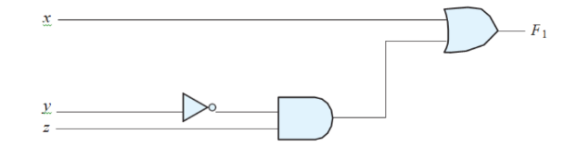
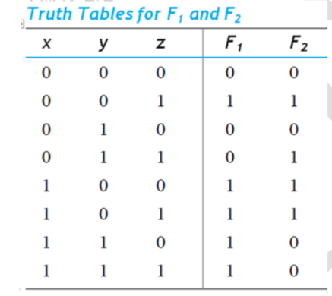
Consider the Boolean function F1 = x + y'z The function F1 is equal to 1 if x is equal to 1 or if both y' and z are equal to 1. F1 is equal to 0 otherwise. Therefore, F1 = 1 if x = 1 or if y = 0 and z = 1.
Dept of CSE

Slide 23
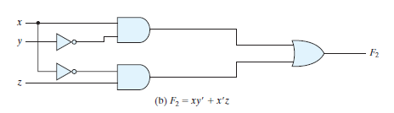
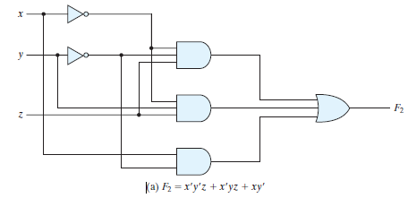
Consider, for example, the following Boolean function: F2 = x'y'z + x'yz + xy'
F2 = x'y'z + x'yz + xy' = x'z(y' + y) + xy' = x'z + xy'
Dept of CSE

Slide 24
Algebraic Manipulation
When a Boolean expression is implemented with logic gates, each term requires a gate and each variable within the term designates an input to the gate.
We define a literal to be a single variable within a term, in complemented or uncomplemented form. The function F2 has three terms and eight literals, and the other one has two terms and four literals.
By reducing the number of terms, the number of literals, or both in a Boolean expression, it is often possible to obtain a simpler circuit.
The manipulation of Boolean algebra consists mostly of reducing an expression for the purpose of obtaining a simpler circuit.
Dept of CSE
F2 = x'y'z + x'yz + xy'
F2= x'z + xy'

Slide 25
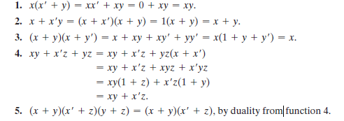
Simplify the following Boolean functions to a minimum number of literals
Dept of CSE

Slide 26
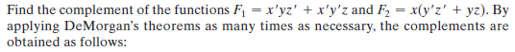
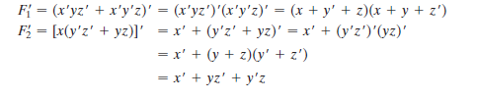
Complement of a Function
The complement of a function F is F and is obtained from an interchange of 0’s for 1’sand 1’s for 0’s in the value of F.
The complement of a function may be derived algebraically through DeMorgan’s theorems.
Dept of CSE

Slide 27
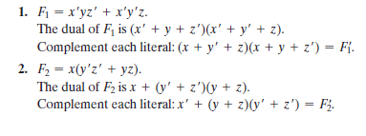
Find the complement of the functions F1 and F2 of Example by taking their duals and complementing each literal.
Dept of CSE

Slide 28
Canonical and Standard Forms
Minterms and Maxterms
A binary variable may appear either in its normal form (x) or in its complement form (x).
Now consider two binary variables x and y combined with an AND operation.
Since each variable may appear in either form, there are four possible combinations: X^{I}y^{I}, x^{I}y, xy^{I} and xy
Each of these four AND terms is called a minterm, or a standard product.
In a similar fashion, n variables forming an OR term, provide 2^{n} possible combinations, called maxterms, or standard sums.
Dept of CSE

Slide 29
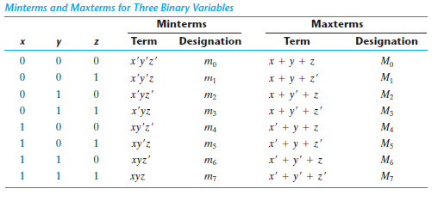
Dept of CSE

Slide 30
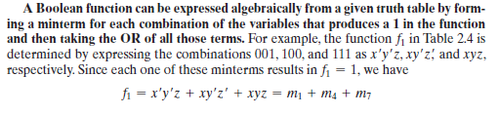
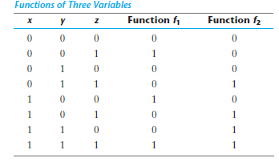
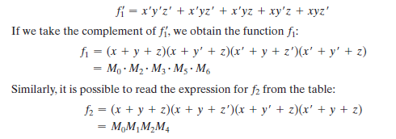
Similarly, it may be easily verified that
Dept of CSE
Now consider the complement of a Boolean function

Slide 31
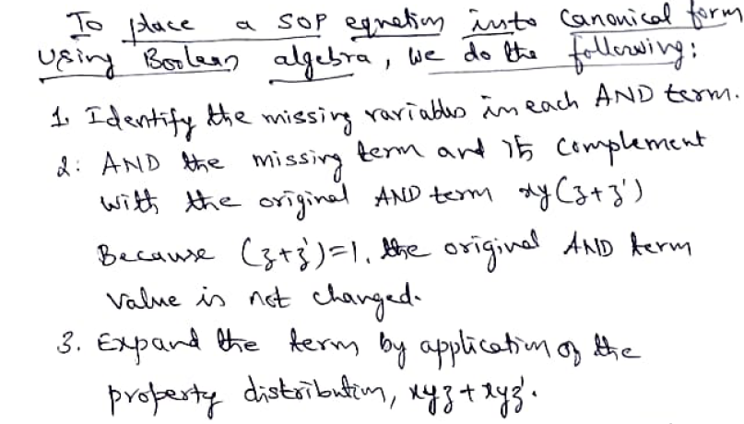
Dept of CSE

Slide 32
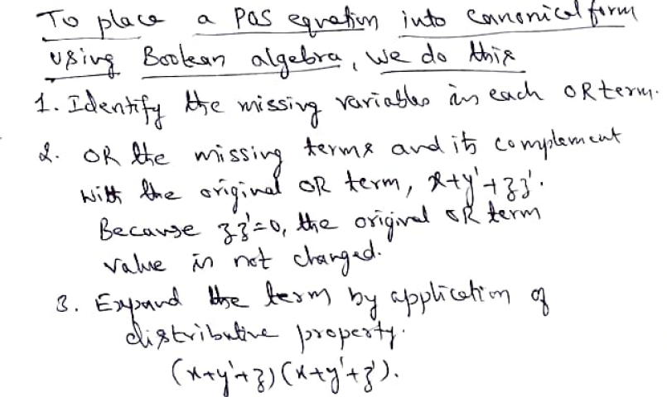
Dept of CSE

Slide 33
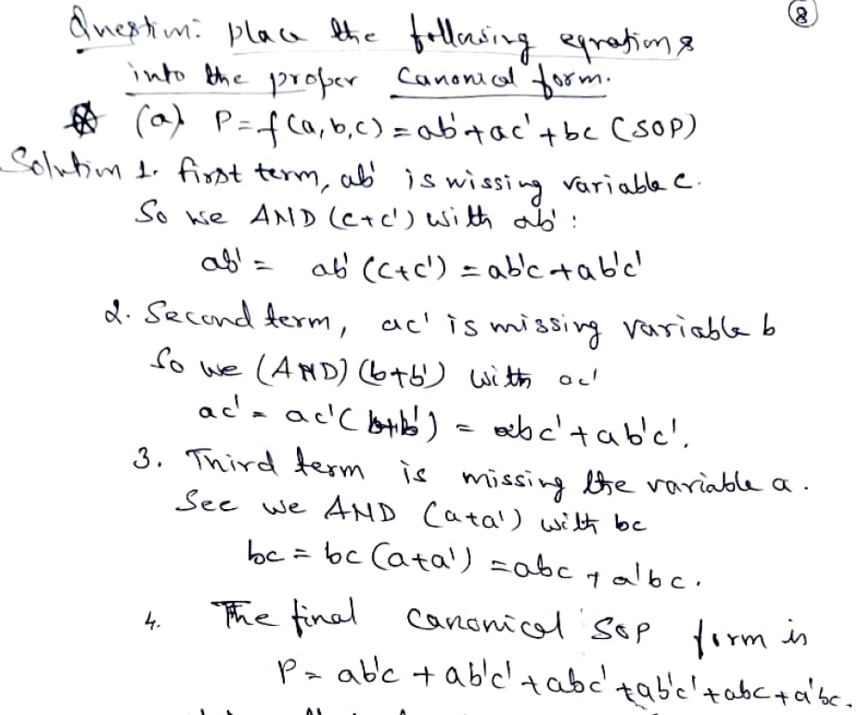
Dept of CSE

Slide 34
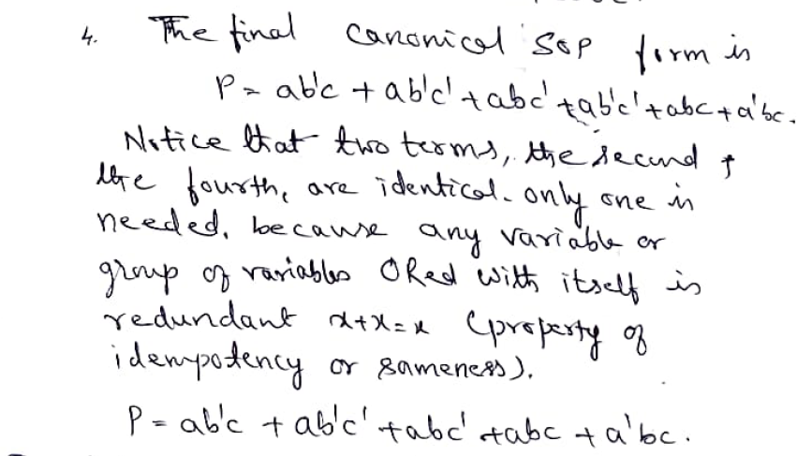
Dept of CSE

Slide 35
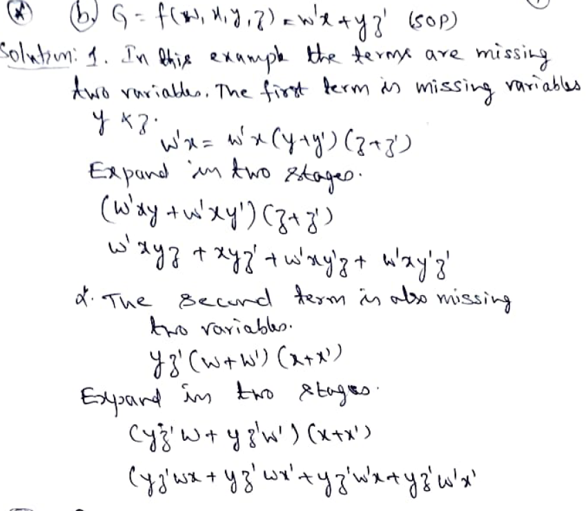
Dept of CSE

Slide 36
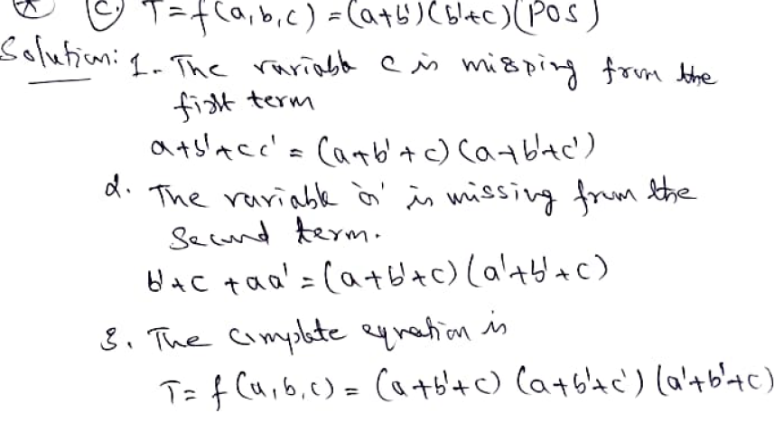
Dept of CSE

Slide 37
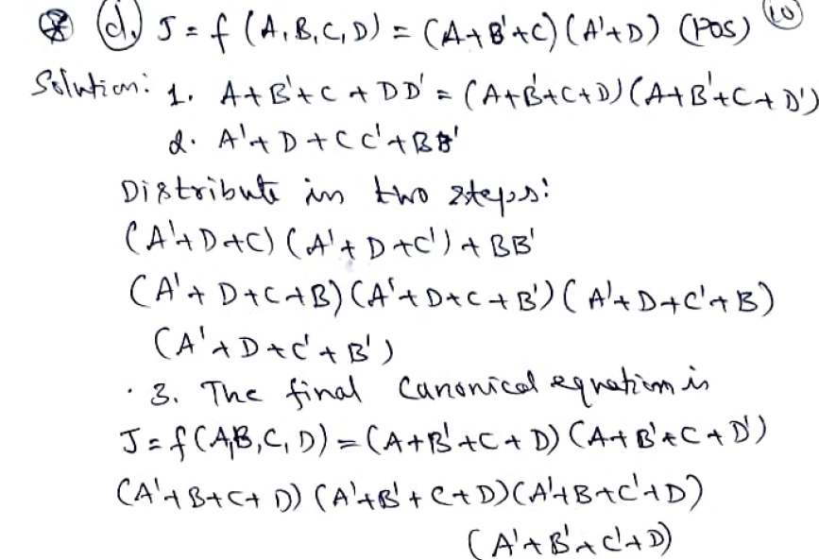
Dept of CSE

Slide 38
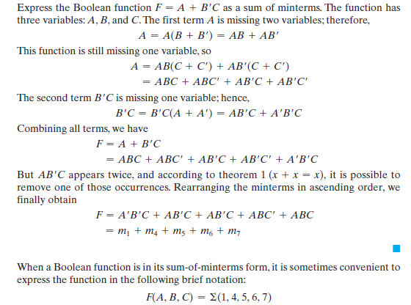
Dept of CSE

Slide 39
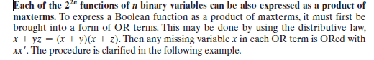
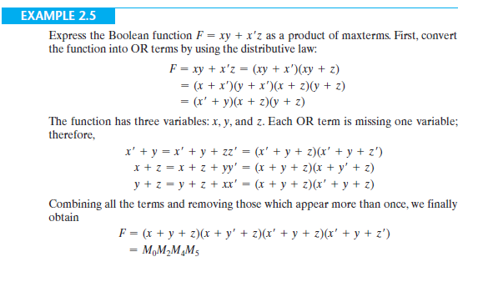
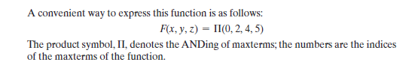
Product of Maxterms
Dept of CSE

Slide 40
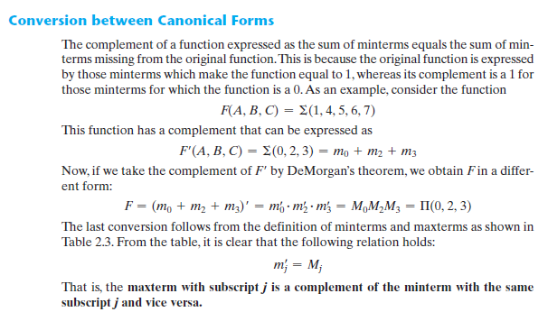
Dept of CSE

Slide 41
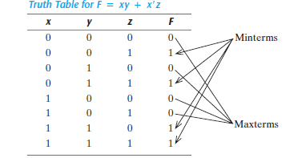
Consider, for example, the Boolean expression
First, we derive the truth table of the function, as shown in Table. The 1’s under F in the table are determined from the combination of the variables for which xy = 11 or xz = 01.
The minterms of the function are read from the truth table to be 1, 3, 6, and 7.
The function expressed as a sum of minterms is F(x, y, z) = (1, 3, 6, 7)
Dept of CSE
Since there is a total of eight minterms or maxterms in a function of three variables, we determine the missing terms to be 0, 2, 4, and 5. The function expressed as a product of
maxterms is
F(x, y, z) = (0, 2, 4, 5)
The same answer as obtained in previous Example

Slide 42
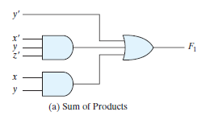
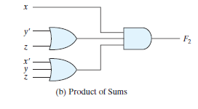
Standard Forms
The sum of products is a Boolean expression containing AND terms, called product terms, with one or more literals each. The sum denotes the ORing of these terms. An example of a function expressed as a sum of products isAn example of a function expressed as a sum of products is
A product of sums is a Boolean expression containing OR terms, called sum terms. Each term may have any number of literals. The product denotes the ANDing of these terms. An example of a function expressed as a product of sums is
Dept of CSE
The expression has three product terms, with one, two, and three literals. Their sum is, in effect, an OR operation.
The expression has three product terms, with one, two, and three literals. Their sum is, in effect, an OR operation.
Fig: Two‐level implementation

Slide 43
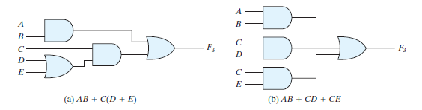
A Boolean function may be expressed in a nonstandard form. For example, the function
F3 = AB + C(D + E)
This is neither in sum‐of‐products nor in product‐of‐sums form. The implementation of this expression is shown in Fig. (a) and requires two AND gates and two OR gates. There are three levels of gating in this circuit.
It can be changed to a standard form by using the distributive law to remove the parentheses:
F3 = AB + C(D + E) = AB + CD + CE
Dept of CSE
Three‐ and two‐level implementation

Slide 44
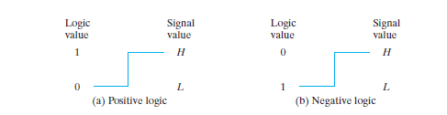
Positive and Negative Logic
The binary signal at the inputs and outputs of any gate has one of two values, except during transition. One signal value represents logic 1 and the other logic 0. Since two signal values are assigned to two logic values, there exist two different assignments of signal level to logic value, as shown in Fig.
The higher signal level is designated by H and the lower signal level by L. Choosing the high‐level H to represent logic 1 defines a positive logic system. Choosing the low‐level L to represent logic 1 defines a negative logic system.
Dept of CSE

Slide 45
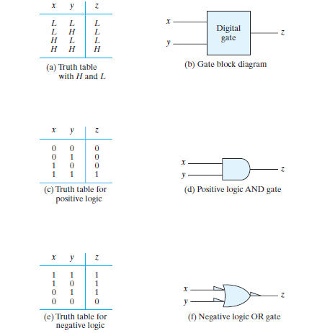
Demonstration of positive and negative logic
Dept of CSE

Slide 46
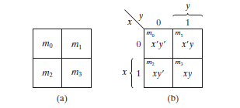
THE MAP METHOD (Karnaugh map or K-map)
The complexity of the digital logic gates that implement a Boolean function is directly related to the complexity of the algebraic expression from which the function is implemented.
Although the truth table representation of a function is unique, when it is expressed algebraically it can appear in many different, but equivalent, forms. Boolean expressions may be simplified by algebraic means as discussed.
However, this procedure of minimization is awkward because it lacks specific rules to predict each succeeding step in the manipulative process. The map method presented here provides a simple, straightforward procedure for minimizing Boolean functions. This method may be regarded as a pictorial form of a truth table. The map method is also known as the Karnaugh map or K-map .
Dept of CSE
Two-Variable K-Map

Slide 47
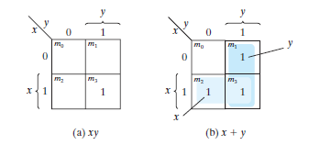
Representation of functions in the map
As an example, the function xy is shown in Fig. (a). Since xy is equal to m3, a 1 is placed inside the square that belongs to m3. Similarly, the function x + y is represented in the map of Fig. (b)
Dept of CSE

Slide 48
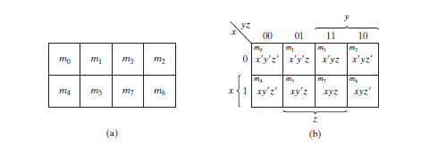
Three-Variable K-Map
A three-variable K-map is shown in Fig. There are eight minterms for three binary variables; therefore, the map consists of eight squares. Note that the minterms are arranged, not in a binary sequence, but in a sequence similar to the Gray code.
The characteristic of this sequence is that only one-bit changes in value from one adjacent
column to the next.
Dept of CSE

Slide 49
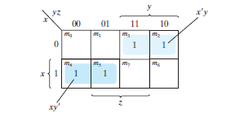
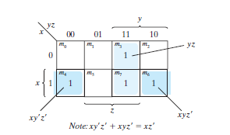
Simplify the Boolean function F (x, y, z) = (2, 3, 4, 5)
Dept of CSE
Simplify the Boolean function F (x, y, z) = (3, 4, 6, 7)

Slide 50
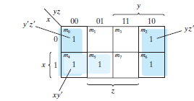

Note:
One square represents one minterm, giving a term with three literals.
Two adjacent squares represent a term with two literals.
Four adjacent squares represent a term with one literal.
Eight adjacent squares encompass the entire map and produce a function that is always equal to 1.
Dept of CSE
Simplify the Boolean function F (x, y, z) = (0, 2, 4, 5, 6)

Slide 51
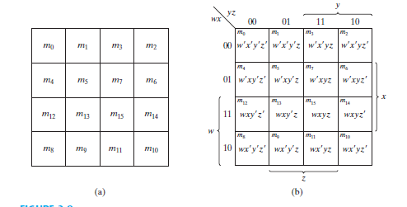
FOUR-VARIABLE K-MAP
The map for Boolean functions of four binary variables (w, x, y, z) is shown in Fig.
Dept of CSE

Slide 52
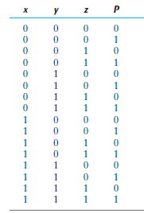
Dept of CSE

Slide 53
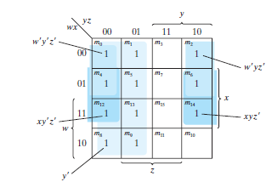
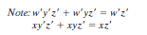
Simplify the Boolean function F (w, x, y, z) = (0, 1, 2, 4, 5, 6, 8, 9, 12, 13, 14)
Dept of CSE

Slide 54
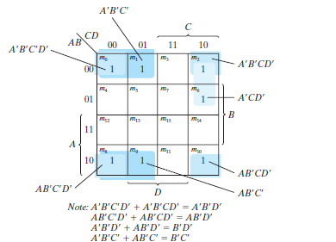
Dept of CSE

Slide 55
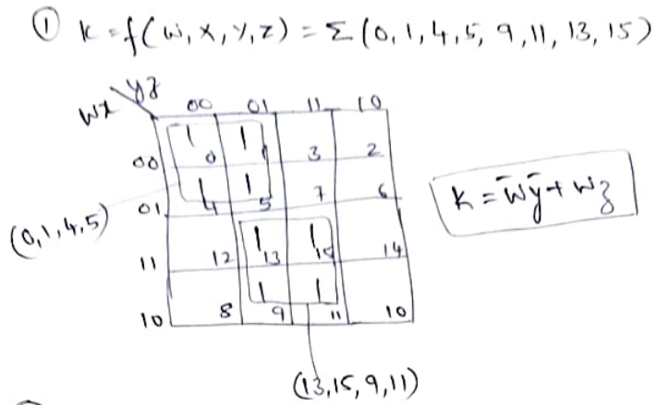
Dept of CSE

Slide 56
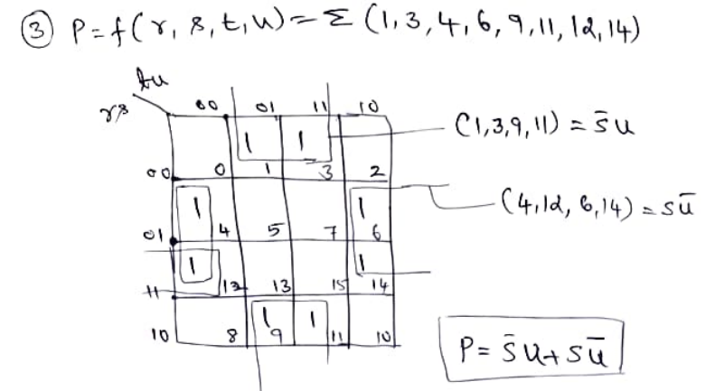
Dept of CSE

Slide 57
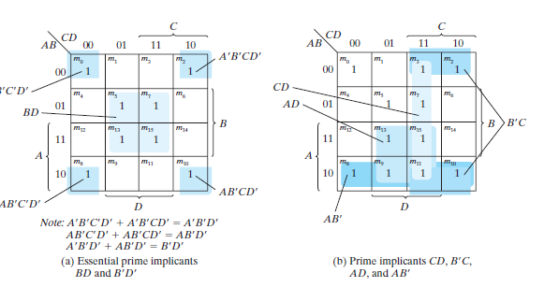
Prime Implicants
A prime implicant is a product term obtained by combining the maximum possible number of adjacent squares in the map. If a minterm in a square is covered by only one prime implicant, that prime implicant is said to be essential.
The prime implicants of a function can be obtained from the map by combining all possible maximum numbers of squares.
Consider the following four-variable Boolean function:
F(A, B, C, D) = (0, 2, 3, 5, 7, 8, 9, 10, 11, 13, 15)
Dept of CSE

Slide 58
DON’T-CARE CONDITIONS
Functions that have unspecified outputs for some input combinations are called incompletely specified functions . In most applications, we simply don’t care what value is assumed by the function for the unspecified minterms.
For this reason, it is customary to call the unspecified minterms of a function don’t-care conditions . These don’t-care conditions can be used on a map to provide further simplification of the Boolean expression.
A don’t-care minterm is a combination of variables whose logical value is not specified.
To distinguish the don’t-care condition from 1’s and 0’s, an X is used. Thus, an X inside a square in the map indicates that we don’t care whether the value of 0 or 1 is assigned to F for the particular minterm
Dept of CSE

Slide 59

Simplify the Boolean function F (w, x, y, z) = (1, 3, 7, 11, 15)
which has the don’t-care conditions d (w, x, y, z) = (0, 2, 5)
Dept of CSE
Either one of the preceding two expressions satisfies the conditions stated for this example.

Slide 60



Dept of CSE

Slide 61

Dept of CSE

Slide 62

Simplify the following Boolean function into (a) sum-of-products form and
(b) product-of-sums form:F (A, B, C, D) = 𝚺(0, 1, 2, 5, 8, 9, 10)
Combining the squares with 1’s gives the simplified function in sum-of-products form:
Dept of CSE
If the squares marked with 0’s are combined, as shown in the diagram, we obtain the simplified complemented function:
Applying DeMorgan’s theorem (by taking the dual and complementing each literal, we obtain the simplified function in productof-sums form:

Slide 63






Consider, for example, the truth table that defines the function F in Table
Dept of CSE
In sum-of-minterms form, this function is expressed as F (x, y, z) = (1, 3, 4, 6)
In product-of-maxterms form, it is expressed as
For the sum of products, we combine
the 1’s to obtain
Taking the complement of F, we obtain the simplified function in
product-of-sums form:
Taking the complement of F, we obtain the simplified function in
product-of-sums form: F

Slide 64
NAND AND NOR IMPLEMENTATION
Digital circuits are frequently constructed with NAND or NOR gates rather than with AND and OR gates. NAND and NOR gates are easier to fabricate with electronic components and are the basic gates used in all IC digital logic families. Because of the prominence of NAND and NOR gates in the design of digital circuits, rules and procedures have been developed for the conversion from Boolean functions given in terms of AND, OR, and NOT into equivalent NAND and NOR logic diagrams.
The NAND gate is said to be a universal gate because any logic circuit can be implemented with it.
Dept of CSE
A convenient way to implement a Boolean function with NAND gates is to obtain the simplified Boolean function in terms of Boolean operators and then convert the function to NAND logic. The conversion of an algebraic expression from AND, OR, and complement to NAND can be done by simple circuit manipulation techniques that change AND–OR diagrams to NAND diagrams.

Slide 65


Dept of CSE
Logic operations with NAND gates
Two graphic symbols for a three-input NAND gate

Slide 66

Two-Level Implementation
The implementation of Boolean functions with NAND gates requires that the functions
be in sum-of-products form.
consider the logic diagrams drawn in Fig. All three diagrams are equivalent and implement the function F = AB + CD
The function is implemented in Fig. (a) with AND and OR gates.
Dept of CSE
The NAND implementation in Fig. (c) can be verified algebraically. The function it implements can easily be converted to sum- of products form by DeMorgan’s theorem:

Slide 67

Implement the following Boolean function with NAND gates: F (x, y, z) = (1, 2, 3, 4, 5, 7)
The first step is to simplify the function into sum-of-products form. This is done by means of the map of Fig. (a), from which the simplified function is obtained:
Dept of CSE

Slide 68

NOR Implementation
Dept of CSE

Slide 69

Figure shows the NOR implementation of a function expressed as a product of sums: F = (A + B)(C + D)E
Dept of CSE

Slide 70
Dept of CSE

Slide 71
Manual methods for designing logic circuits are feasible only when the circuit is small.
For anything else (i.e., a practical circuit), designers use computer-based design tools. Coupled with the correct-by-construction methodology, computer-based design tools leverage the creativity and the effort of a designer and reduce the risk of producing a flawed design.
Prototype integrated circuits are too expensive and time consuming to build, so all modern design tools rely on a hardware description language to describe, design, and test a circuit in software before it is manufactured.
A hardware description language (HDL) is a computer-based language that describes the hardware of digital systems in a textual form. It resembles an ordinary computer programming language, such as C, but is specifically oriented to describing hardware structures and the behavior of logic circuits.
It can be used to represent logic diagrams, truth tables, Boolean expressions, and complex abstractions of the behavior of a digital system.
Dept of CSE

Slide 72
One way to view an HDL is to observe that it describes a relationship between signals that are the inputs to a circuit and the signals that are the outputs of the circuit.
For example, an HDL description of an AND gate describes how the logic value of the gate’s output is determined by the logic values of its inputs.
As a documentation language, an HDL is used to represent and document digital systems in a form that can be read by both humans and computers and is suitable as an exchange language between designers.
Dept of CSE
HDLs are used in several major steps in the design flow of an integrated circuit:
1.Design entry
2.Functional simulation or verification,
3.Logic synthesis,
4.Timing verification, and
5.Fault simulation.

Slide 73
Design entry creates an HDL-based description of the functionality that is to be implemented in hardware.
Depending on the HDL, the description can be in a variety of forms: Boolean logic equations, truth tables, a netlist of interconnected gates, or an abstract behavioral model.
The HDL model may also represent a partition of a larger circuit into smaller interconnected and interacting functional units. Logic simulation displays the behavior of a digital system through the use of a computer.
A simulator interprets the HDL description and either produces readable output, such as a time-ordered sequence of input and output signal values, or displays waveforms of the signals.
The simulation of a circuit predicts how the hardware will behave before it is actually fabricated. Simulation detects functional errors in a design without having to physically create and operate the circuit.
Errors that are detected during a simulation can be corrected by modifying the appropriate HDL statements.
Dept of CSE

Slide 74
Logic synthesis is the process of deriving a list of physical components and their interconnections (called a netlist ) from the model of a digital system described in an HDL.
The netlist can be used to fabricate an integrated circuit or to lay out a printed circuit board with the hardware counterparts of the gates in the list.
Timing verification confirms that the fabricated, integrated circuit will operate at a specified speed.
Because each logic gate in a circuit has a propagation delay, a signal transition at the input of a circuit cannot immediately cause a change in the logic value of the output of a circuit.
Propagation delays ultimately limit the speed at which a circuit can operate. Timing verification checks each signal path to verify that it is not compromised by propagation delay.
Dept of CSE

Slide 75
Companies that design integrated circuits use proprietary and public HDLs.
In the public domain, there are two standard HDLs that are supported by the IEEE:
1.VHDL
2.Verilog.
VHDL is a Department of Defense–mandated language. (The V in VHDL stands for the first letter in VHSIC, an acronym for very high-speed integrated circuit.) Verilog began as a proprietary HDL of Cadence Design Systems.
Dept of CSE
A Verilog model is composed of text using keywords, of which there are about 100.
Keywords are predefined lowercase identifiers that define the language constructs.
Examples of keywords are module, endmodule, input, output, wire, and, or, and not.
For clarity, keywords will be displayed in boldface in the text in all examples of code and wherever it is appropriate to call attention to their use.

Slide 76
Any text between two forward slashes ( // ) and the end of the line is interpreted as a comment and will have no effect on a simulation using the model.
Multiline comments begin with / * and terminate with * /.
Blank spaces are ignored, but they may not appear within the text of a keyword, a user-specified identifier, an operator, or the representation of a number.
Verilog is case sensitive, which means that uppercase and lowercase letters are distinguishable (e.g., not is not the same as NOT).
The term module refers to the text enclosed by the keyword pair module . . . endmodule.
A module is the fundamental descriptive unit in the Verilog language.
It is declared by the keyword module and must always be terminated by the keyword endmodule.
Dept of CSE

Slide 77


The HDL description of the circuit of Fig. is shown in HDL Example
Dept of CSE
The first line of text is a comment (optional) providing useful information to the reader.
The second line begins with the keyword module and starts the declaration (description) of the module; the last line completes the declaration with the keyword endmodule.
The keyword module is followed by a name and a list of ports.

Slide 78
// Verilog model of circuit of Figure
Dept of CSE

Slide 79

Gate Delays
All physical circuits exhibit a propagation delay between the transition of an input and a resulting transition of an output.
When an HDL model of a circuit is simulated, it is sometimes necessary to specify the amount of delay from the input to the output of its gates.
In Verilog, the propagation delay of a gate is specified in terms of time units and by the symbol #. The numbers associated with time delays in Verilog are dimensionless.
Dept of CSE

Slide 80
Test bench
An HDL description that provides the stimulus to a design is called a test bench.
Here, we demonstrate the procedure with a simple example HDL Example shows a test bench for simulating the circuit with delay. (Note the distinguishing name Simple_Circuit_prop_ delay .)
In its simplest form, a test bench is a module containing a signal generator and an instantiation of the model that is to be verified.
Note that the test bench ( t_Simple_ Circuit_prop_delay ) has no input or output ports, because it does not interact with its environment.
In general, we prefer to name the test bench with the prefix t_ concatenated with the name of the module that is to be tested by the test bench, but that choice is left to the designer.
Dept of CSE

Slide 81


Test bench with example
Dept of CSE

Slide 82
Boolean Expressions
Boolean equations describing combinational logic are specified in Verilog with a continuous assignment statement consisting of the keyword assign followed by a Boolean expression.
To distinguish arithmetic operators from logical operators, Verilog uses the symbols (&), (/), and (&) for AND, OR, and NOT (complement), respectively.
Thus, to describe the simple circuit of Fig. with a Boolean expression, we use the statement
Dept of CSE

Slide 83


HDL Example describes a circuit that is specified with the following two Boolean expressions:
The equations specify how the logic values E and F are determined by the values of A, B, C, and D .
Dept of CSE

Slide 84
User-Defined Primitives
The logic gates used in Verilog descriptions with keywords and, or, etc., are defined by the system and are referred to as system primitives.
The user can create additional primitives by defining them in tabular form. These types of circuits are referred to as user-defined primitives (UDPs).
One way of specifying a digital circuit in tabular form is by means of a truth table.
UDP descriptions do not use the keyword pair module . . . endmodule.
Instead, they are declared with the keyword pair primitive . . . endprimitive.
The best way to demonstrate a UDP declaration is by means of an example.
Dept of CSE

Slide 85
HDL Example defines a UDP with a truth table. It proceeds according to the
following general rules:
• It is declared with the keyword primitive, followed by a name and port list.
• There can be only one output, and it must be listed first in the port list and declared with keyword output.
• There can be any number of inputs. The order in which they are listed in the input declaration must conform to the order in which they are given values in the table that follows.
• The truth table is enclosed within the keywords table and endtable.
• The values of the inputs are listed in order, ending with a colon (:). The output is always the last entry in a row and is followed by a semicolon (;).
• The declaration of a UDP ends with the keyword endprimitive.
Dept of CSE

Slide 86


HDL Example (User-Defined Primitive)
Dept of CSE

